Slide 1
CreditOne
Defining the Data Science Process

Slide 2

Mission - From Inquiry to Insight to Impact
Using the BADIR Data Science Framework we will examine the data to fully assess business and profit loss due to issues in accuracy of credit scoring, as well as determining if and how to predict customer creditworthiness and identifying correlations in demographic data that may determine the likelihood of customer default.

Slide 3
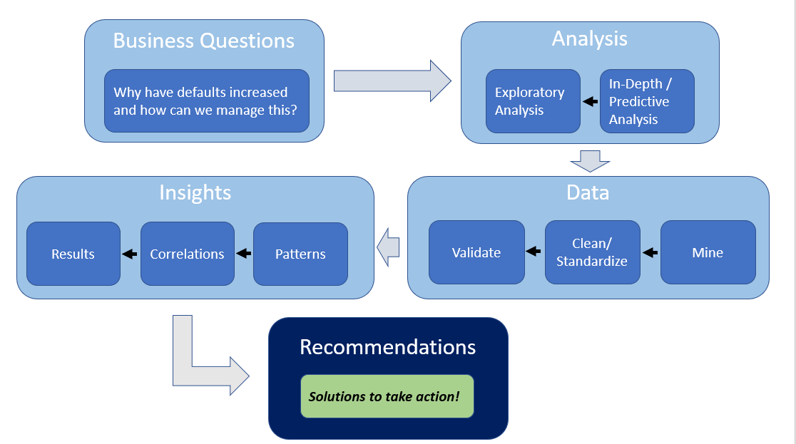

Slide 4
Business Questions
Why is there a recent increase in number of customers who default on loans and how can we ensure customers will repay their loans?
Can creditworthiness be measured? > What factors can be used to decide if credit should be issued? > How can we determine the amount of credit to issue a customer?
What factors predict creditworthiness? > Do certain customer demographic data allow us to understand customer credit limits as well as predict loan default or repayment?
Notes:
The ultimate question is WHAT DO THE STAKEHOLDERS WANT TO ACHIEVE?????

Slide 5
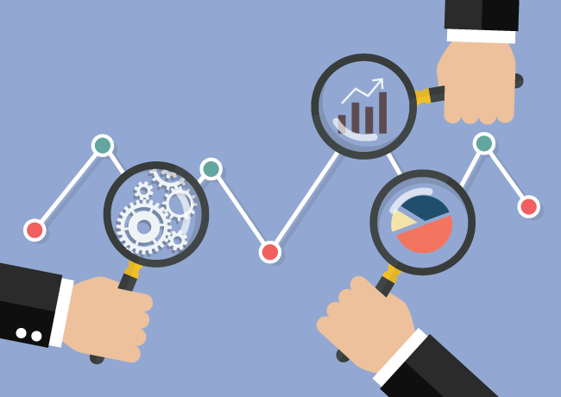
Analysis Plan
Begin with an Exploratory Data Analysis to investigate the increase in the number of customer loan defaults. By understanding more about the data and how it relates to customer habits, we can then conduct an In-Depth Analysis to examine what factors correlate with loan default, and finally, create predictive models to offer actionable recommendations that raise accuracy of credit scoring and minimize profit loss.

Slide 6
Data
The data for this analysis is mined from CreditOne’s external database capturing customer information including:
Age
Gender
Marital Status
Education Level
Credit Amount
Default Status
History of Past Payment (including measurement of 6 month repayment breakdown)
The mined data is then cleaned using tools accessible in python to discover and correct inconsistencies such as duplicates, missing values, corrupt or irrelevant data, etc. The data is inspected to ensure standardization, quality, and validity to provide an accurate and workable dataset to perform our analyses and create predictive models. Even with only a brief review of this data it is expected this step may be quite time consuming based on cleaning issues already observed.

Slide 7

Insights
Patterns found in the data will be reported and assessed for usefulness and confidence to provide reliable predictions.
Machine Learning models are then created and tested to determine best option for prediction accuracy.
Deeper understanding of the data at this point may lead to a redefining or reexamining of goals and used to fine tune the model for more specific insight, greater accuracy, and narrowed focus for maximum impact solutions.

Slide 8
Recommendations
Unfortunately, there is little to be learned from this data as is.
Further analysis as outlined is needed to explore the data for trends, insights, and best fit for machine learning models before predictions of customer behavior and/or recommendations of how to proceed can be offered confidently.
Additional input and/or recommendations from management concerning expectations and goals for this project is greatly welcomed.

